Slide 1
BLAST:
Basic Local Alignment Search Tool

Slide 2
Outline
Algorithm behind BLAST
Statistics behind BLAST

Slide 3
Outline - CHANGES
Rigorously define score of HSP
What is K and lambda in the “Expected number of HSPs” slide
The formalas in “Bit score” slide are unclear

Slide 4
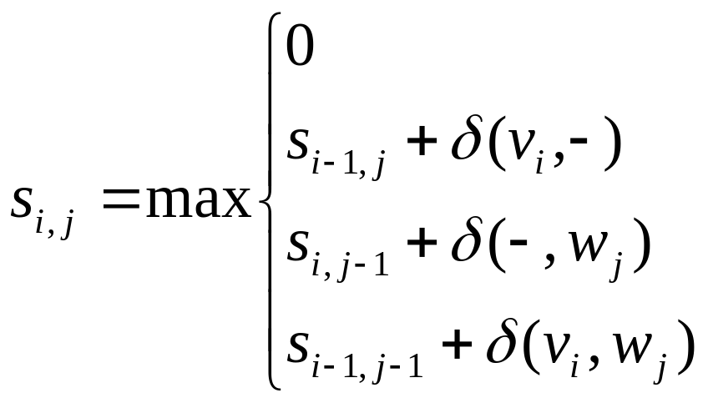
Local alignment is to slow…
Quadratic local alignment is two slow while looking for similarities between long strings (e.g. the entire GenBank database)

Slide 5
Interpreting New Words with a Dictionary
Encountering a new word: “rucksack”
  Meaningless without a dictionary or some point of reference
Encountering a DNA or protein sequence:
  Need a point of reference
  No dictionary available but thesaurus exists
Rucksack: backpack, bag, purse
  Does not give exact meaning, but helps with understanding

Slide 6
What Similarity Reveals
BLASTing a new gene
  Evolutionary relationship
  Similarity between protein function
BLASTing a genome
  Potential genes

Slide 7
BLAST
Basic Local Alignment Search Tool
  Altschul, S.F., Gish, W., Miller, W.,
  Myers, E.W. & Lipman, D.J.
    Journal of Molecular Biology
    v. 215, 1990, pp. 403-410
Used to search sequence databases for local alignments to a query

Slide 8
BLAST algorithm
Keyword search of all words of length w from the in the query of length n in database of length m with score above threshold
  w = 11 for nucleotide queries, 3 for proteins
Do local alignment extension for each found keyword
  Extend result until longest match above threshold is achieved
Running time O(nm)

Slide 9
BLAST algorithm (cont’d)
keyword
Query: KRHRKVLRDNIQGITKPAIRRLARRGGVKRISGLIYEETRGVLKIFLENVIRD
GVK 18
GAK 16
GIK 16
GGK 14
GLK 13
GNK 12
GRK 11
GEK 11
GDK 11
Neighborhood
words
neighborhood
score threshold
(T = 13)
extension
Query: 22 VLRDNIQGITKPAIRRLARRGGVKRISGLIYEETRGVLK 60
+++DN +G + IR L G+K I+ L+ E+ RG++K
Sbjct: 226 IIKDNGRGFSGKQIRNLNYGIGLKVIADLV-EKHRGIIK 263
High-scoring Pair (HSP)

Slide 10
Original BLAST
Dictionary
  All words of length w
Alignment
  Ungapped extensions until score falls below some threshold
Output
  All local alignments with score > statistical threshold

Slide 11
Original BLAST: Example
A C G A A G T A A G G T C C A G T
w = 4
Exact keyword match of GGTC
Extend diagonals with mismatches until score is under 50%
Output result
  GTAAGGTCC
  GTTAGGTCC
C T G A T C C T G G A T T G C G A
From lectures by Serafim Batzoglou (Stanford)

Slide 12
Gapped BLAST: Example
A C G A A G T A A G G T C C A G T
Original BLAST exact keyword search, THEN:
Extend with gaps in a zone around ends of exact match
Output result
  GTAAGGTCCAGT
  GTTAGGTC-AGT
C T G A T C C T G G A T T G C G A
From lectures by Serafim Batzoglou (Stanford)

Slide 13
Gapped BLAST : Example (cont’d)
A C G A A G T A A G G T C C A G T
Original BLAST exact keyword search, THEN:
Extend with gaps around ends of exact match until score < threshold, then merge nearby alignments
Output result
  GTAAGGTCCAGT
  GTTAGGTC-AGT
C T G A T C C T G G A T T G C G A
From lectures by Serafim Batzoglou (Stanford)

Slide 14
Incarnations of BLAST
blastn: Nucleotide-nucleotide
blastp: Protein-protein
blastx: Translated query vs. protein database
tblastn: Protein query vs. translated database
tblastx: Translated query vs. translated database (6 frames each)

Slide 15
Incarnations of BLAST (cont’d)
PSI-BLAST
  Find members of a protein family or build a custom position-specific score matrix
  Bootstrapping results to find very related sequences
Megablast:
  Search longer sequences with fewer differences
WU-BLAST: (Wash U BLAST)
  Optimized, added features

Slide 16
Assessing sequence similarity
Need to know how strong an alignment can be expected from chance alone
“Chance” is the comparison of
  Real but non-homologous sequences
  Real sequences that are shuffled to preserve compositional properties
  Sequences that are generated randomly based upon a DNA or protein sequence model (favored)

Slide 17
High Scoring Pairs (HSPs)
All segment pairs whose scores can not be improved by extension or trimming
Need to model a random sequence to analyze how high the score is in relation to chance

Slide 18
Model Random Sequence
Necessary to evaluate the score of a match
Take into account background
  Adjust for G+C content
  Poly-A tails
  “Junk” sequences
  Codon bias

Slide 19
Expected number of HSPs
Expected number of HSPs with score > S
E-value E for the score S:
  E = Kmn2^{-λS}
Given:
  Two sequences, length n and m
  The statistics of HSP scores are characterized by two parameters K and λ
    K: scale for the search space size
    λ: scale for the scoring system

Slide 20
Bit Scores
Normalized score to be able to compare sequences
Bit score
  S’ = λS – ln(K)
  ln(2)
E-value of bit score
  E = mn2^{-S’}

Slide 21
P-values
The probability of finding b HSPs with a score >=S is given by:
  (e^{-E}E^{b})/b!
For b = 0, that chance is:
  e^{-E}
Thus the probability of finding at least one such HSP is:
  P = 1 – e^{-E}

Slide 22
Assessing the significance of an alignment
How to assess the significance of an alignment while comparing a protein of length m to a database?
Calculate a "database search" E-value. Multiply the pairwise-comparison E-value by the number of sequences in the database N divided by the length of the database n

Slide 23
Sample BLAST output
Blast of human beta globin protein against zebra fish
Score E
Sequences producing significant alignments: (bits) Value
gi|18858329|ref|NP_571095.1| ba1 globin [Danio rerio] >gi|147757... 171 3e-44
gi|18858331|ref|NP_571096.1| ba2 globin; SI:dZ118J2.3 [Danio rer... 170 7e-44
gi|37606100|emb|CAE48992.1| SI:bY187G17.6 (novel beta globin) [D... 170 7e-44
gi|31419195|gb|AAH53176.1| Ba1 protein [Danio rerio] 168 3e-43
ALIGNMENTS
>gi|18858329|ref|NP_571095.1| ba1 globin [Danio rerio]
Length = 148
Score = 171 bits (434), Expect = 3e-44
Identities = 76/148 (51%), Positives = 106/148 (71%), Gaps = 1/148 (0%)
Query: 1 MVHLTPEEKSAVTALWGKVNVDEVGGEALGRLLVVYPWTQRFFESFGDLSTPDAVMGNPK 60
MV T E++A+ LWGK+N+DE+G +AL R L+VYPWTQR+F +FG+LS+P A+MGNPK
Sbjct: 1 MVEWTDAERTAILGLWGKLNIDEIGPQALSRCLIVYPWTQRYFATFGNLSSPAAIMGNPK 60
Query: 61 VKAHGKKVLGAFSDGLAHLDNLKGTFATLSELHCDKLHVDPENFRLLGNVLVCVLAHHFG 120
V AHG+ V+G + ++DN+K T+A LS +H +KLHVDP+NFRLL + + A FG
Sbjct: 61 VAAHGRTVMGGLERAIKNMDNVKNTYAALSVMHSEKLHVDPDNFRLLADCITVCAAMKFG 120
Query: 121 KE-FTPPVQAAYQKVVAGVANALAHKYH 147
+ F VQ A+QK +A V +AL +YH
Sbjct: 121 QAGFNADVQEAWQKFLAVVVSALCRQYH 148

Slide 24
Sample BLAST output (cont’d)
Blast of human beta globin DNA against human DNA
Score E
Sequences producing significant alignments: (bits) Value
gi|19849266|gb|AF487523.1| Homo sapiens gamma A hemoglobin (HBG1... 289 1e-75
gi|183868|gb|M11427.1|HUMHBG3E Human gamma-globin mRNA, 3' end 289 1e-75
gi|44887617|gb|AY534688.1| Homo sapiens A-gamma globin (HBG1) ge... 280 1e-72
gi|31726|emb|V00512.1|HSGGL1 Human messenger RNA for gamma-globin 260 1e-66
gi|38683401|ref|NR_001589.1| Homo sapiens hemoglobin, beta pseud... 151 7e-34
gi|18462073|gb|AF339400.1| Homo sapiens haplotype PB26 beta-glob... 149 3e-33
ALIGNMENTS
>gi|28380636|ref|NG_000007.3| Homo sapiens beta globin region (HBB@) on chromosome 11
Length = 81706
Score = 149 bits (75), Expect = 3e-33
Identities = 183/219 (83%)
Strand = Plus / Plus
Query: 267 ttgggagatgccacaaagcacctggatgatctcaagggcacctttgcccagctgagtgaa 326
|| ||| | || | || | |||||| ||||| ||||||||||| ||||||||
Sbjct: 54409 ttcggaaaagctgttatgctcacggatgacctcaaaggcacctttgctacactgagtgac 54468
Query: 327 ctgcactgtgacaagctgcatgtggatcctgagaacttc 365
||||||||| |||||||||| ||||| ||||||||||||
Sbjct: 54469 ctgcactgtaacaagctgcacgtggaccctgagaacttc 54507

